Slide 1

Java course
-10-

Slide 2
10.JQuery

Slide 3

What is jQuery?
jQuery is a lightweight, "write less, do more", JavaScript library.
The purpose of jQuery is to make it much easier to use JavaScript on your website.
jQuery takes a lot of common tasks that require many lines of JavaScript code to accomplish, and wraps them into methods that you can call with a single line of code.
jQuery also simplifies a lot of the complicated things from JavaScript, like AJAX calls and DOM manipulation.

Slide 4
Adding jQuery to you`re project

Slide 5
Syntax
The jQuery syntax is tailor-made for selecting HTML elements and performing some action on the element(s).
Basic syntax is: $(selector).action()
A $ sign to define/access jQuery
A (selector) to "query (or find)" HTML elements
A jQuery action() to be performed on the element(s)

Slide 6
Syntax Examples
$(this).hide() - hides the current element.
$("p").hide() - hides all <p> elements.
$(".test").hide() - hides all elements with class="test".
$("#test").hide() - hides the element with id="test".

Slide 7
Document Ready Event
$(document).ready(function(){ // jQuery methods go here... });
This is to prevent any jQuery code from running before the document is finished loading (is ready).
It is good practice to wait for the document to be fully loaded and ready before working with it. This also allows you to have your JavaScript code before the body of your document, in the head section.
Here are some examples of actions that can fail if methods are run before the document is fully loaded:
Trying to hide an element that is not created yet
Trying to get the size of an image that is not loaded yet

Slide 8
Selector Syntax
$(this) Selects the current HTML element
$("p.intro") Selects all <p> elements with class="intro"
$("p:first") Selects the first <p> element
$("ul li:first") Selects the first <li> element of the first <ul>
$("ul li:first-child") Selects the first <li> element of every <ul>
$("[href]") Selects all elements with an href attribute
$("a[target='_blank']") Selects all <a> elements with a target attribute value equal to "_blank"
$("a[target!='_blank']") Selects all <a> elements with a target attribute value NOT equal to "_blank"
$(":button") Selects all <button> elements and <input> elements of type="button"
$("tr:even") Selects all even <tr> elements
$("tr:odd") Selects all odd <tr> elements

Slide 9
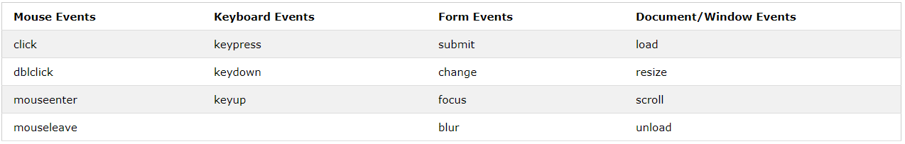
Events

Slide 10
Callback
jQuery Callback Functions
JavaScript statements are executed line by line. However, with effects, the next line of code can be run even though the effect is not finished. This can create errors.
To prevent this, you can create a callback function.
A callback function is executed after the current effect is finished.
Typical syntax: $(selector).hide(speed,callback);

Slide 11
Chaining
Until now we have been writing jQuery statements one at a time (one after the other).
However, there is a technique called chaining, that allows us to run multiple jQuery commands, one after the other, on the same element(s).
Tip: This way, browsers do not have to find the same element(s) more than once.
To chain an action, you simply append the action to the previous action.
Example : $("#paragraf").css("color", "red").slideUp(1000).slideDown(500);

Slide 12
DOM Handling
One very important part of jQuery is the possibility to manipulate the DOM.
jQuery comes with a bunch of DOM related methods that make it easy to access and manipulate elements and attributes.
DOM = Document Object Model
Three simple, but useful, jQuery methods for DOM manipulation are:
text() - Sets or returns the text content of selected elements
html() - Sets or returns the content of selected elements (including HTML markup)
val() - Sets or returns the value of form fields
attr() method is used to get attribute values

Slide 13
AJAX
AJAX is the art of exchanging data with a server, and updating parts of a web page - without reloading the whole page.
AJAX = Asynchronous JavaScript and XML.
In short; AJAX is about loading data in the background and display it on the webpage, without reloading the whole page.
Syntax : $(selector).load(URL,data,callback);
Example
$(“.buton").click(function(){ $("#div1").load(“<api_url>",{parametru1:”<vlaoare>”,patametru2:”<valoare>”}, function(responseTxt, statusTxt, xhr){ if(statusTxt == "success") alert("External content loaded successfully!"); if(statusTxt == "error") alert("Error: " + xhr.status + ": " + xhr.statusText); }); });

Slide 14
HTTP GET vs POST
Syntax:
$.get(URL,callback);
$.post(URL,data,callback);
$("button").click(function(){ $.post(“testApi", -> API address {name: “Vlad Ciocan"}, -> data sent function(data, status){ ->callback function alert(data); }); });

Slide 15
Done.

Slide 16
That`s it for today
Session review
-You learned jQuery
-You learned AJAX requests
-You learned DOM`s
GOOD JOB! ☺

